Slide 1
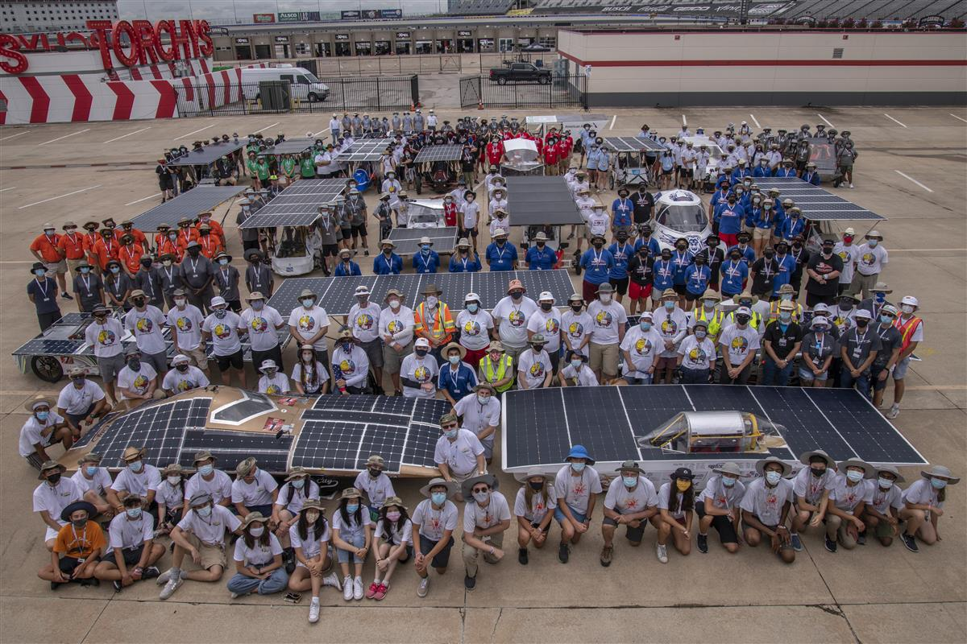
WELCOME TO THE 2022
SOLAR CAR CHALLENGE

Slide 2
Why Participate in the Solar Car Challenge
Problem-Solving and Collaboration
Dedication and Commitment – the
“do not quit” attitude
Project-Based Engineering
Learning to deal with Success and Failure
Learn about Budgets and Public Speaking
Learn the importance of teamwork

Slide 3
RACE AGENDA FOR 2022
(1) Registration Deadline – March 1st
(2) Oral Presentation Video Deadline – June 1st
(3) Team Scrapbook Deadline – June 15th
(4) Liability Insurance Deadline – July 1st
(5) Team Check-In – Wednesday, July 13th
Everyone taking part must be there!
(6) Scrutineering – July 14-16th
(7) Cross-Country Race Begins – July 17th
(8) Race Finish – July 23rd [Colorado]

Slide 4
What’s Emphasized In 2022
Crush Zone / Roll Cage / Roll Bar
We will be developing a better understanding of the crush zone / roll cage / roll bar to improve safety.
New Cruiser Class
(1) Four wheel cruiser seating 4 passengers facing forward, each having their own separate means for entry & egress
(2) Totally enclosed body with array integrated on skin of the vehicle. Requires working trunk.
(3) Points awarded based on distance traveled times the number of passengers.

Slide 5
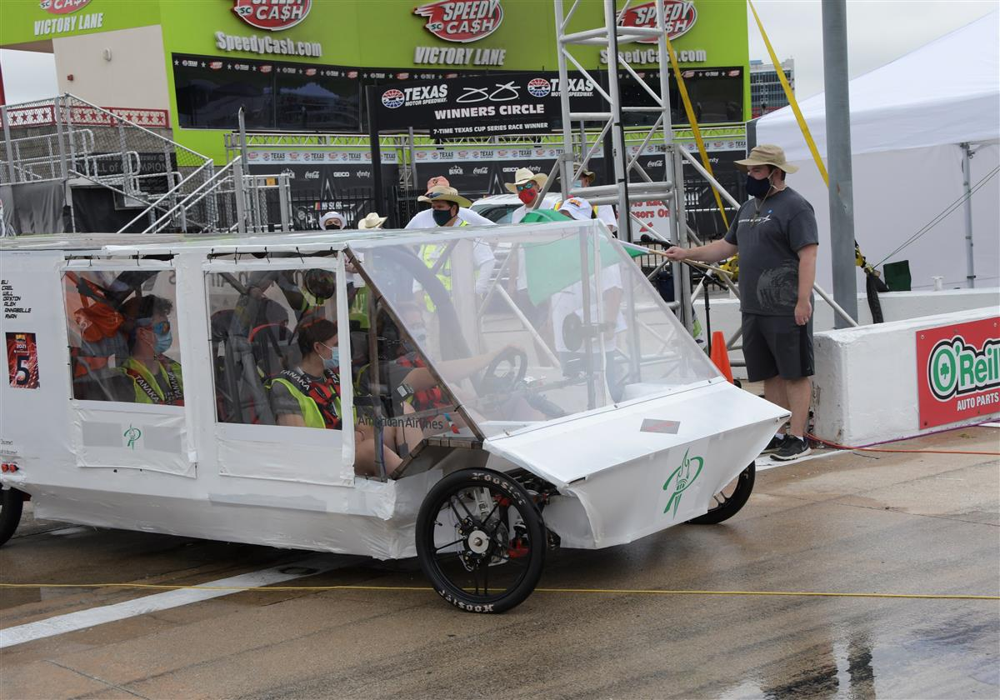

Slide 6
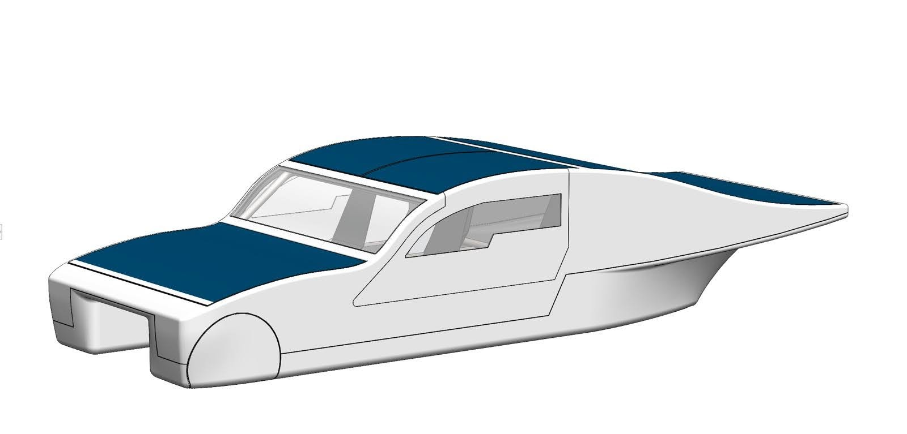
FAU High School CAD Drawing of Cruiser

Slide 7
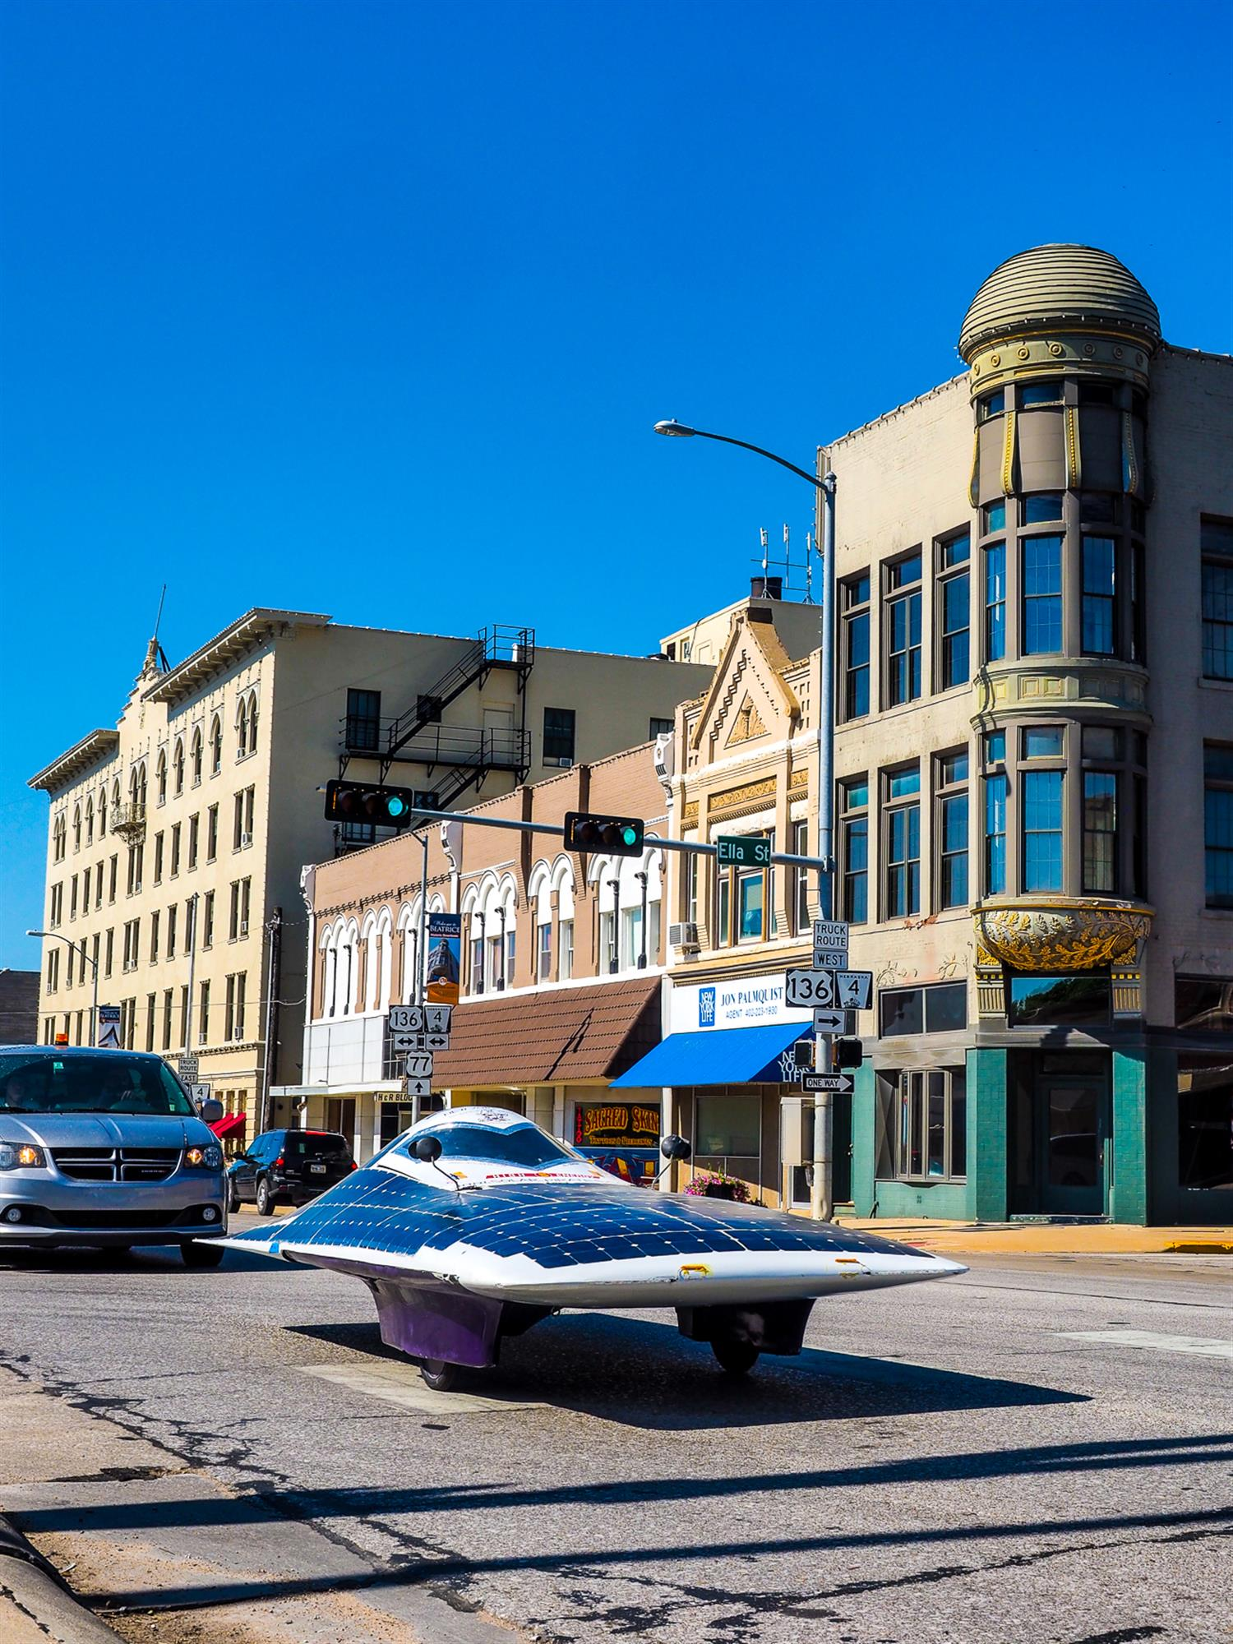
Now, it’s time to start preparing for the 2022 Solar Car Challenge

Slide 8
What is our Philosophy?

Slide 9
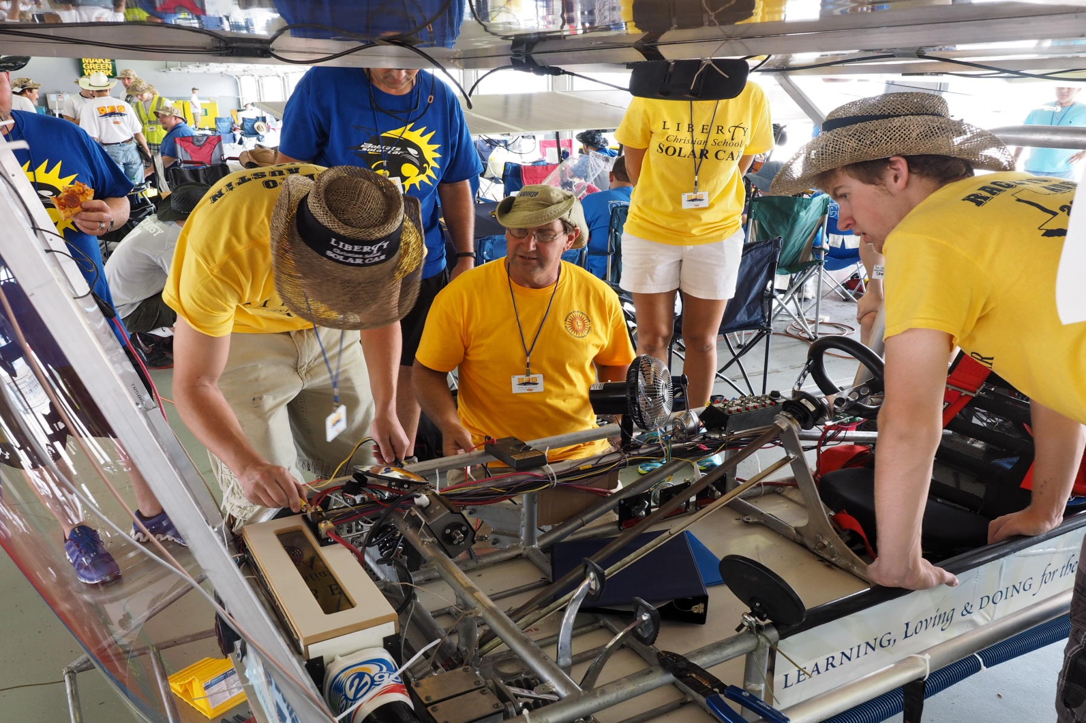
This is a Cooperation rather than a Competition

Slide 10
Where do we start?

Slide 11
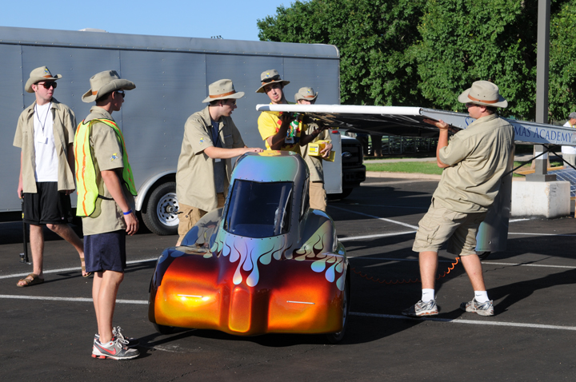
Start with Team-Building

Slide 12
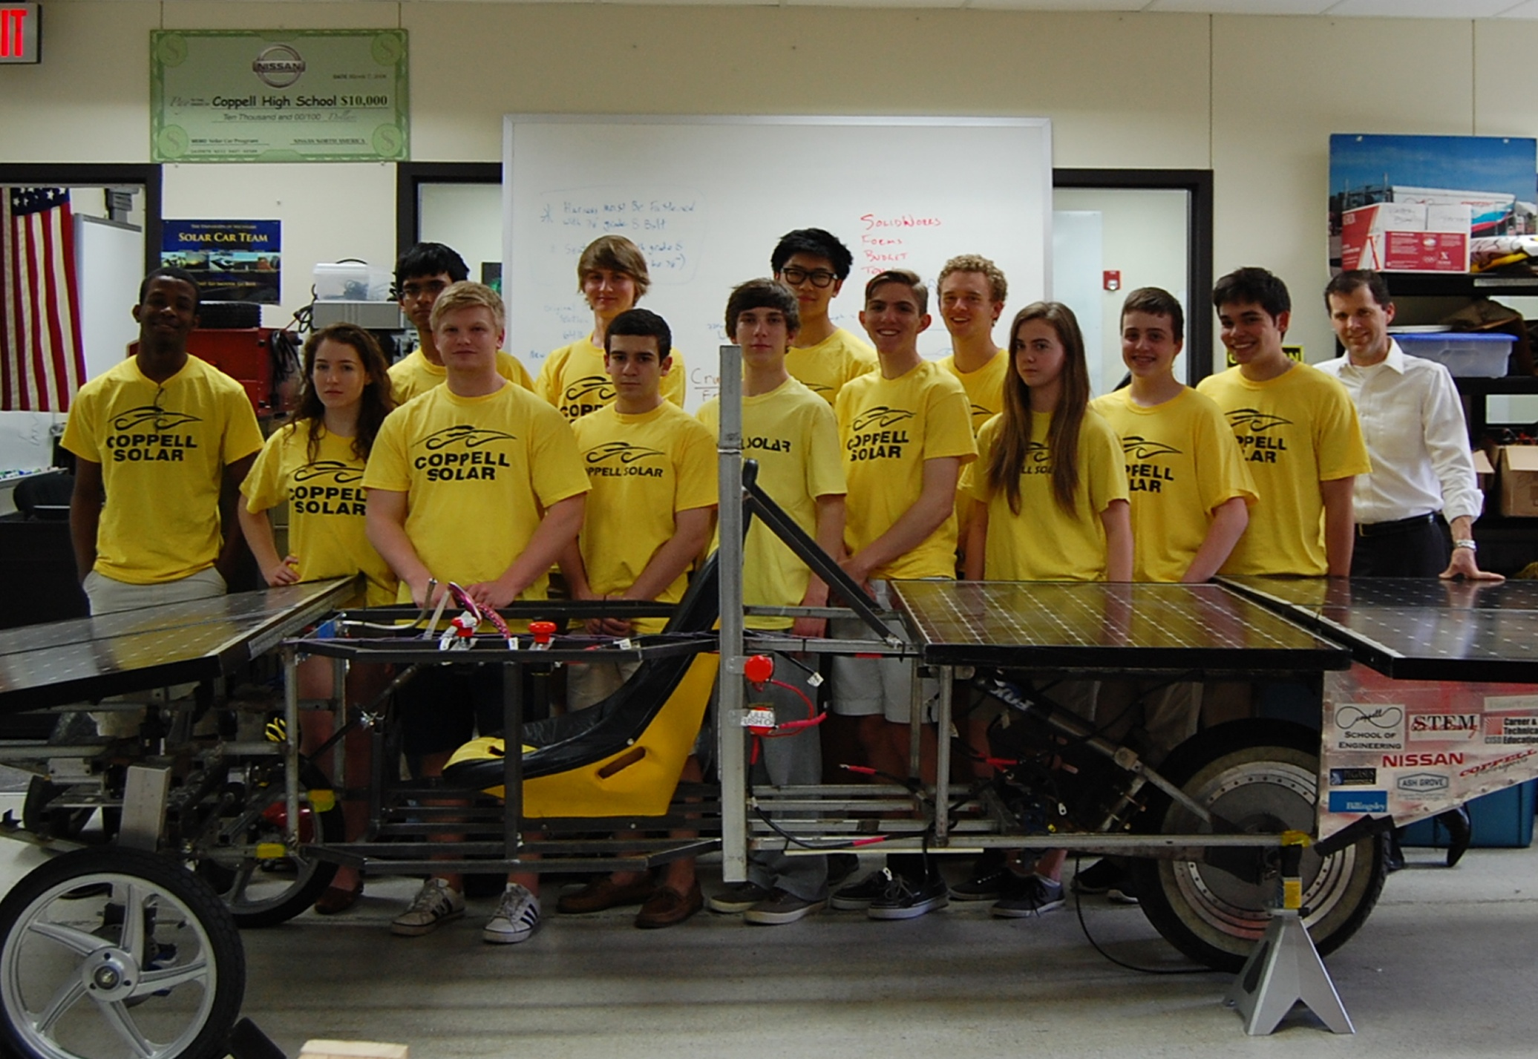
How BIG a team?

Slide 13
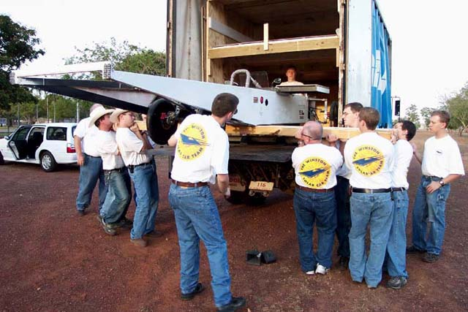
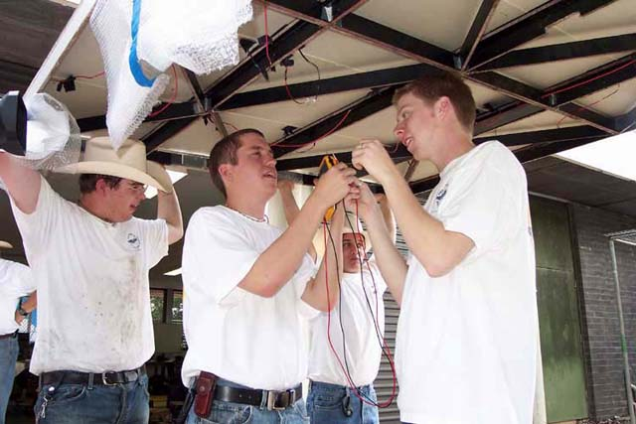
Be sure to have
enough team members to
accomplish the
task involved!

Slide 14
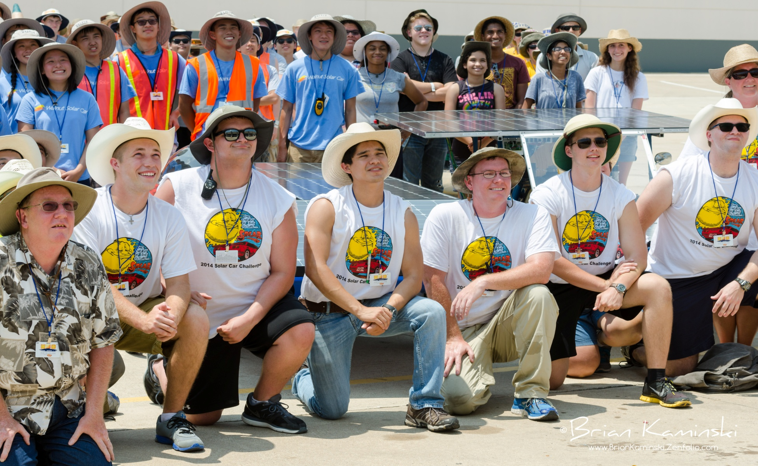
Develop the Role of Team Captain

Slide 15
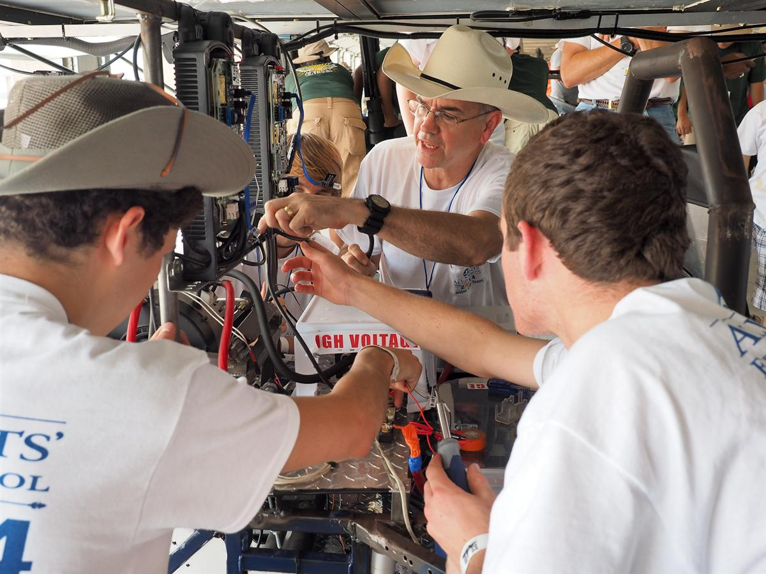
Is the team vested in the project?

Slide 16
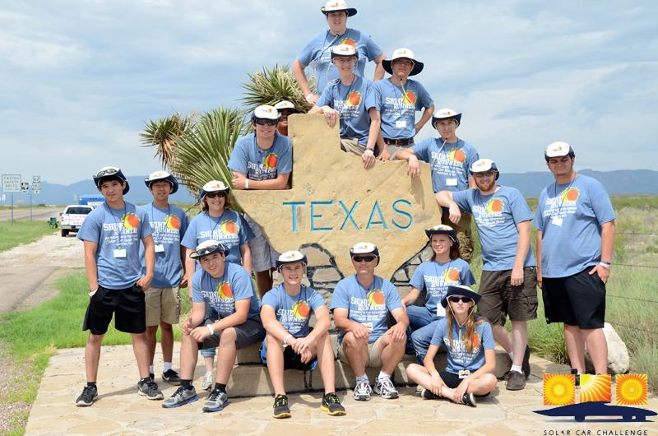
Techniques for developing long term team & parent support

Slide 17
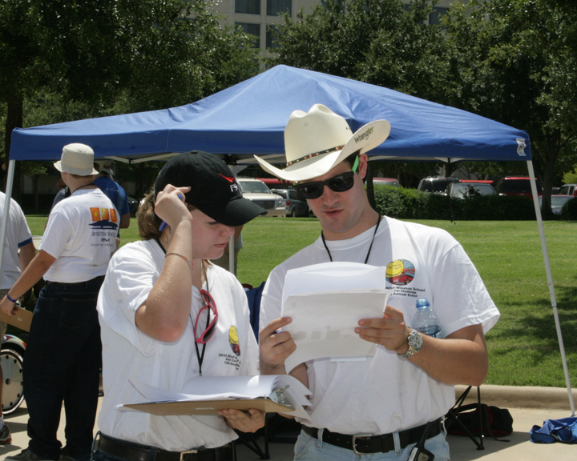
Read the Rules Together
(many times)

Slide 18
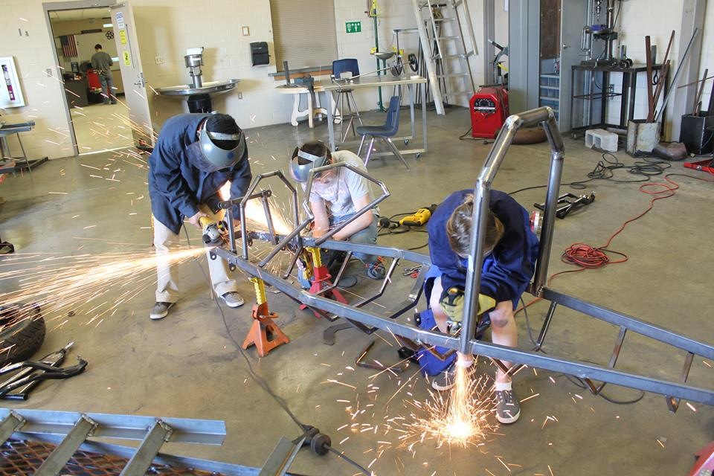
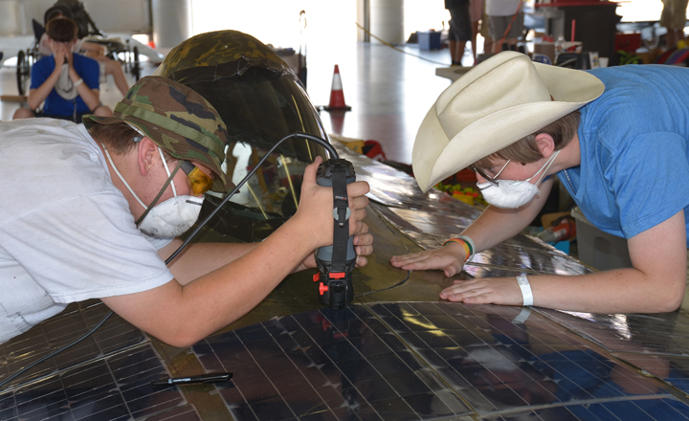
The importance of building skills

Slide 19
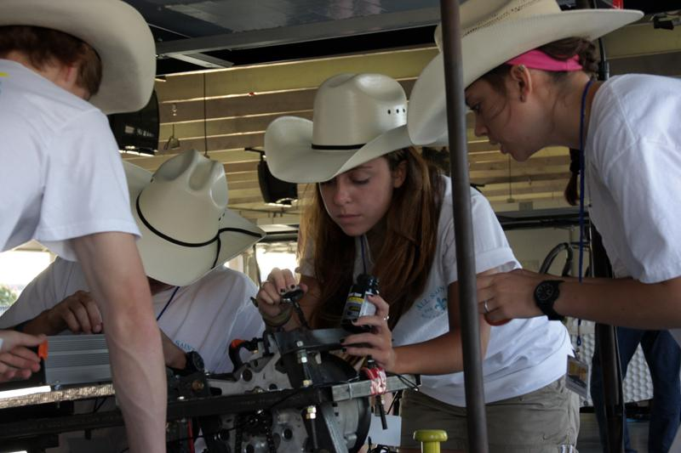

Slide 20
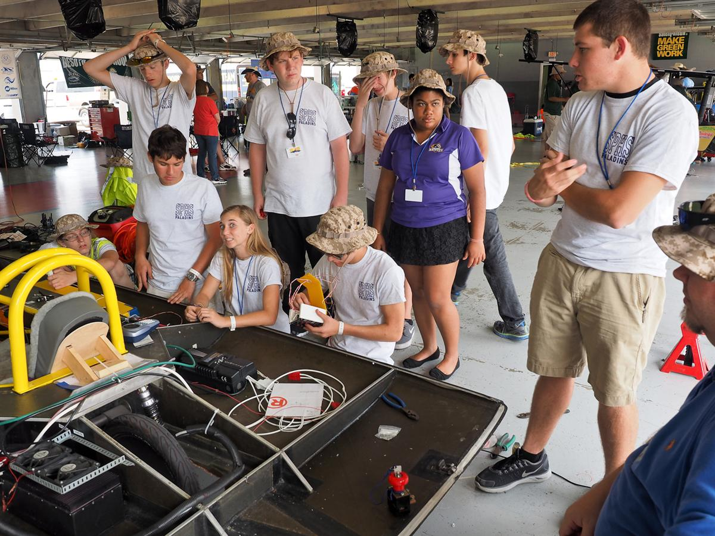
Importance of Goal-Setting and following a Timeline

Slide 21
TIMELINE
Plan Develop Fundraising Buy Build Re-Engineer Test Race Post And Promo Car Race
Design Materials Eval
____________________________________________
Sept Early Oct Oct Nov Dec - Mar Apr - May July Aug

Slide 22
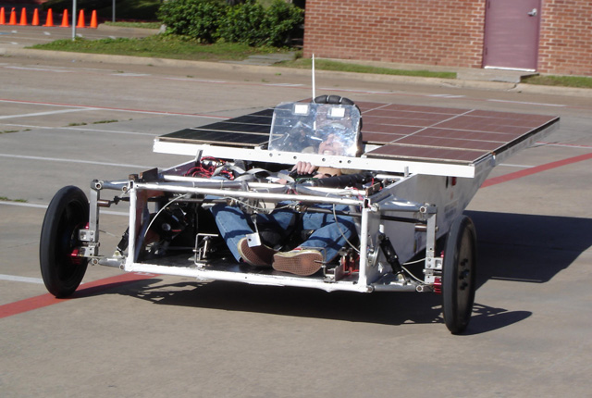
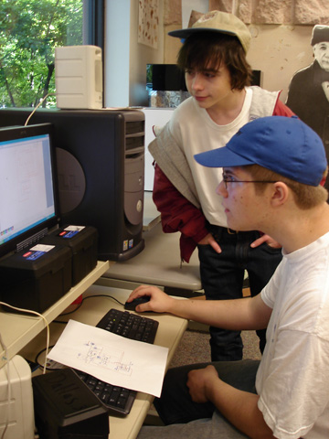
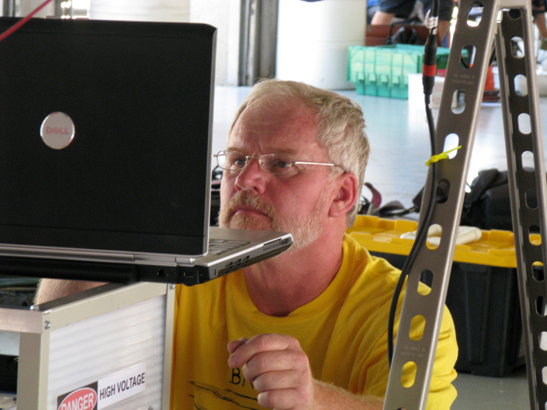
Importance of Testing

Slide 23
The Reality of Testing
The three Teams that did not pass Scrutineering in 2019 never tested their vehicles before arriving at the race.
Recommendation: Put 500 miles on your solar car before you ever get to the Race. You want to “break” you car at home . . not at the race.
Please don’t show up at the race with an incomplete solar car!

Slide 24



Post-Race Evaluation

